Slide 1
COP509: Natural Language Processing Scoring, Term Weighting, The Vector Space Model
Dr Georgina Cosma
Notes:
Hello everyone, and welcome back to another session on NLP. In today’s session we will cover Ranked Retrieval and scoring, term weighting, and the Vector Space Model. This session is split into mini lectures since there are around 50 slides altogether.

Slide 2
Outline
Why ranked retrieval?
Term frequency
tf-idf weighting
The vector space model
Notes:
So we will start with an introduction to why we need ranked retrieval, then discuss the concepts of term frequency, we look look at the tf-idf weighting scheme, and the vector space model.

Slide 3
Ranked retrieval
Thus far, our queries have all been Boolean.
Documents either match or don’t.
Good for expert users with precise understanding of their needs and of the collection.
Not good for the majority of users
Most users are not capable of writing Boolean queries .
Most users don’t want to wade through 1000s of results.
This is particularly true of web search.
‹#›
Notes:
So in the previous session we our queries have all been Boolean. With Boolean queries documents either match or don’t.
Boolean queries are good for expert users with precise understanding of their needs and of the collection.
However, Boolean queries are Not good for the majority of users. Most users are not capable of writing Boolean queries . . .
. . . or they are, but they think it’s too much work.
Most users don’t want to go through 1000s of results to search for the most relevant documents.
This is particularly true of web search.

Slide 4
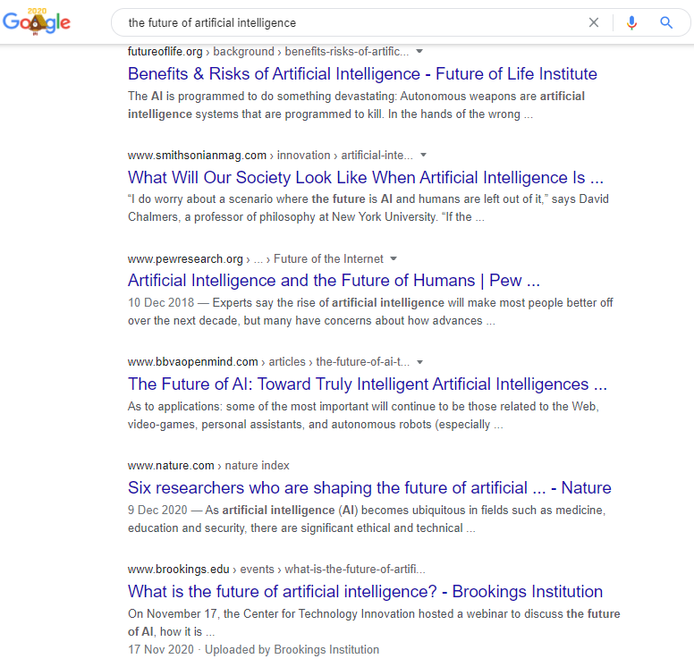
Scoring as the basis of ranked retrieval
We wish to rank documents that are more relevant higher than documents that are less relevant.
How can we accomplish such a ranking of the documents in the collection with respect to a query?
Assign a score to each query-document pair, say in [0, 1].
This score measures how well document and query “match”.
query
Ranked results
‹#›
Notes:
Now let’s look at scoring.
When we score retrieved documents, the aim is to rank documents that are more relevant higher than documents that are less relevant.
But how can we accomplish such a ranking of the documents in the collection with respect to a query?
Assign a score to each query-document pair, say in [0, 1].
This score measures how well document and query “match”. So, in the sessions that follow we will go through how to best do this task.

Slide 5
Query-document matching scores
How do we compute the score of a query-document pair?
Let’s start with a one-term query.
If the query term does not occur in the document: score should be 0.
The more frequent the query term in the document, the higher the score
We will look at a number of alternatives for doing this.
‹#›
Notes:
How do we compute the score of a query-document pair?
Let’s start with a one-term query.
If the query term does not occur in the document: score should be 0.
The more frequent the query term in the document, the higher the score
We will look at a number of alternatives for doing this.

Slide 6

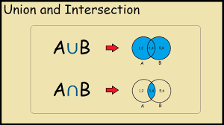
Take 1: Jaccard coefficient
A commonly used measure of overlap of two sets
Let A and B be two sets
Jaccard coefficient:
JACCARD (A, A) = 1
JACCARD (A, B) = 0 if A ∩ B = 0
A and B don’t have to be the same size.
Always assigns a number between 0 and 1.
For example: Set A can be the set containing the query terms, and set B can be the set containing the document terms.
A and B don’t share common terms
‹#›
Notes:
We will first look at the Jaccard coefficient before we look at better solutions that are based on the Vector Space Model and weighting schemes.
The Jaccard coefficient is a commonly used measure of overlap of two sets
Let A and B be two sets, for example, A can be the set containing the query terms, and B can be the set containing the document terms
Then we can compute the Jaccard coefficient using the formula: A intersection B over A union B. So, A intersection B will give us the total number of terms the set A and B have in common, and A Union B is the number of unique terms in the sets A and B. So, is the query and document have the exact terms and hence match perfectly then then coefficent will be 1, and if they have no terms in common then the coefficient will be 0. A and B don’t have to be the same size and Always assigns a number between 0 and 1.

Slide 7
Jaccard coefficient: Example
What is the query-document match score that the Jaccard coefficient computes for:
Query: “flowers of March”
Document “Caesar died in March”
JACCARD(q, d) = 1/6
The JACCARD(q, d) coefficient for the query and document is 1 over 6 which is a score of 0.17
‹#›
Notes:
What is the query-document match score that the Jaccard coefficient computes for:
Assume we have a query: “flowers of March”
The Document contains the text “Caesar died in March”
The JACCARD(q, d) coefficient for the query and document is 1 over 6 which is a score of 0.17
A intersection B is 1, because there is only one term in common, and that term is March
A union B is the total number of words, and these are ide, of, March, Caesar died, in = 6 words.

Slide 8
What’s wrong with Jaccard?
It doesn’t consider term frequency (how many occurrences a term has).
Rare terms are more informative than frequent terms. Jaccard does not consider this information.
We need a more sophisticated way of normalizing for the length of a document.
Later in this lecture, we’ll use (cosine) instead of Jaccard for length normalization.
More info here: https://towardsdatascience.com/overview-of-text-similarity-metrics-3397c4601f50
‹#›
Notes:
What’s wrong with Jaccard coeffiecient
It doesn’t consider term frequency (how many occurrences a term has).
Rare terms are more informative than frequent terms. Jaccard does not consider this information.
We need a more sophisticated way of normalizing for the length of a document. The longer the document is, the more likely all the keywords will be found (and with higher frquency).
Later in this lecture, we’ll use (cosine) instead of Jaccard for length normalization. Document length normalization adjusts the term frequency or the relevance score in order to normalize the effect of document length on the document ranking. So that the length of the

Slide 9
Exercise
Compute the Jaccard matching score for the following query-document pairs.
q: [information on cars] d: “all you’ve ever wanted to know about cars”
q: [information on cars] d: “information on trucks, information on planes, information on trains”
q: [red cars and red trucks] d: “cops stop red cars more often”
‹#›

Slide 10
Outline
Why ranked retrieval?
Term frequency
tf-idf weighting
The vector space model

